Slide 1
Swarm Intelligence

Slide 2
Swarm intelligence is the collective behavior of decentralized, self-organized systems, natural or artificial or Swarm intelligence refers to collective intelligence.
The main principles of the collective behavior are:
Homogeneity: every bird in flock has the same behavior model. The flock moves without a leader, even though temporary leaders seem to appear.
Locality: the motion of each bird is only influenced by its nearest flock mates. Vision is considered to be the most important senses for flock organization.
Collision avoidance: avoid collision with nearby flock mates.
Velocity matching: attempt to match velocity with nearby flock mates.
Flock centering: attempt to stay close to nearby flock mates.

Slide 3
Individuals attempt to maintain a minimum distance between themselves and oth­ers at all times. Thus this is the highest priority rule.
If individuals each other do not perform an avoidance maneuver, they tend to be attracted towards each other.

Slide 4
Four collective dynamical behaviours were identied by Couzin et al. Namely:
Torus: individuals perpetually rotate around an empty core (milling). The direction of rotation is random.
Dynamic Parallel Group: the individuals are polarized and move as a coherent group, but individuals can move throughout the group and density and group form can fluctuate
Swarm : an aggregate with cohesion, but a low level of polarization (parallel alignment) among members
Highly Parallel Group: much more static in terms of exchange of spatial positions within the group than the dynamic parallel group and the variation in density and form is minimal.

Slide 5
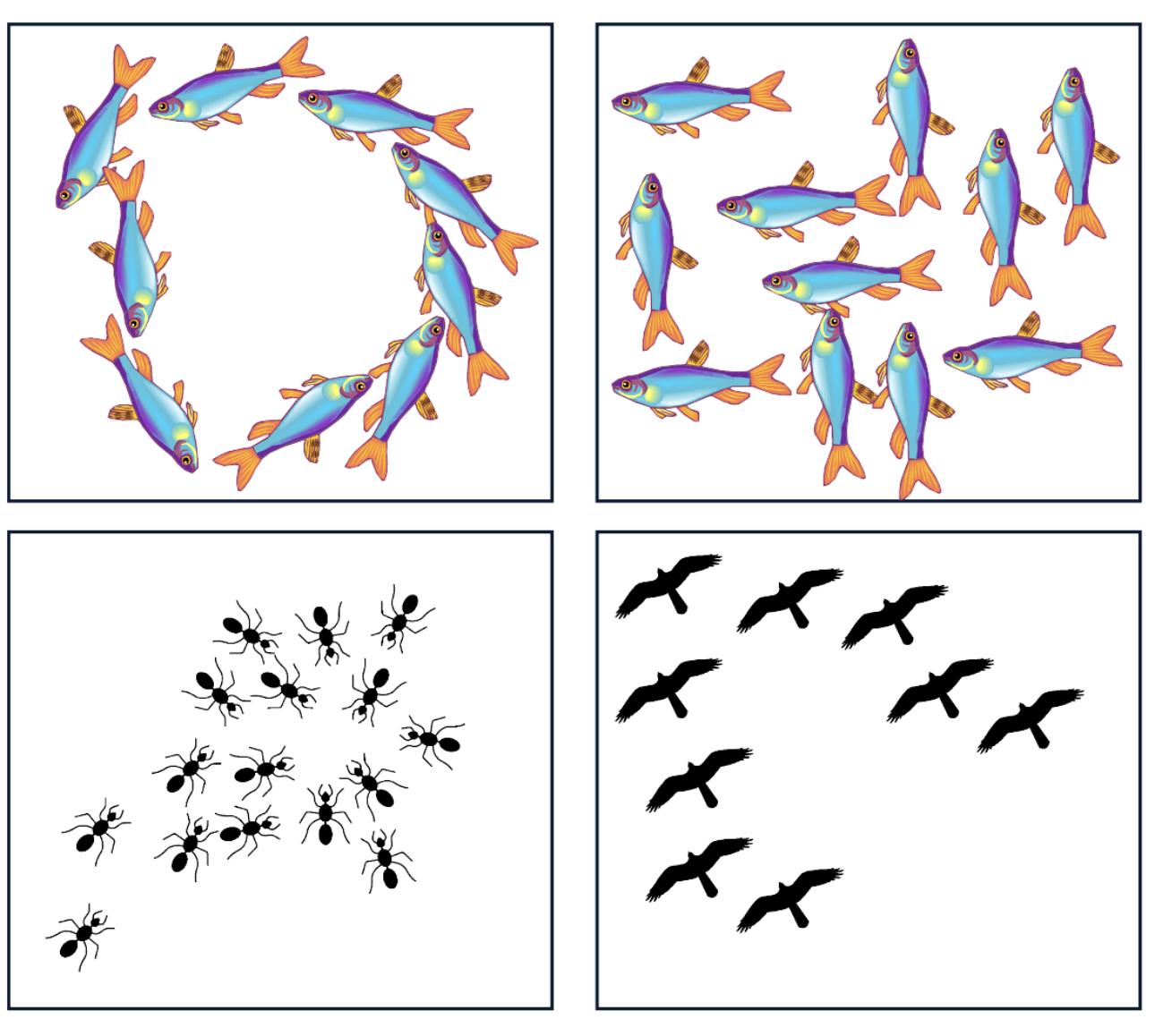
Top Left - Torus
Top Right - Dynamic Parallel Group
Bottom Left - Swarm
Bottom Right - Highly Parallel Group

Slide 6
The Particle Swarm Optimization (PSO)
The PSO consist of a swarm of particles, which are initiated with a population of random candidate solutions.
They move iteratively through the d-dimension problem space to search the new solutions, where the fitness, f, can be calculated as the certain qualities measure.
Each particle has a position represented by a position-vector xi (i is the index of the particle), and a velocity represented by a velocity-vector vj.
Each particle remembers its own best position so far in a vector X_{i}# , and its j-th dimensional value is X_{ij}#.

Slide 7
The Particle Swarm Optimization (PSO)
The best position-vector among the swarm so far is then stored in a vector x*, and its j-th dimensional value is X_{j}*.
During the iteration time t, the update of the velocity from the previous velocity to the new velocity is determined by equation A
The new position is then determined by the sum of the previous position and the new velocity by equation B
V_{ij}(t+1)=wv_{ij}(t)+c₁r₁(x_{ij}#(t)- x_{ij}(t))+ c₂r₂(x_{j}*(t)- x_{ij}#(t)) =A
X_{ij}(t+1) = x_{ij}(t)+ V_{ij}(t+1) =B
where w = inertia factor
r₁ & r₂ are the random numbers which are used to maintain the diversity of the population and are uniformly distributed in the interval [0,1] for the j-th dimension of the i-th particle.

Slide 8
The Particle Swarm Optimization (PSO)
c₁ is a positive constant, called as coefficient of the self-recognition component, c₂ is a positive constant, called as coefficient of the social component.
In order to guide the particles effectively in the search space, the maximum moving distance during one iteration must be clamped in between the maximum velocity [- v_{max}, v_{max}] given in equation C:
v_{ij} = sign (v_{ij}) min(|v_{ij}|, v_{max})

Slide 9
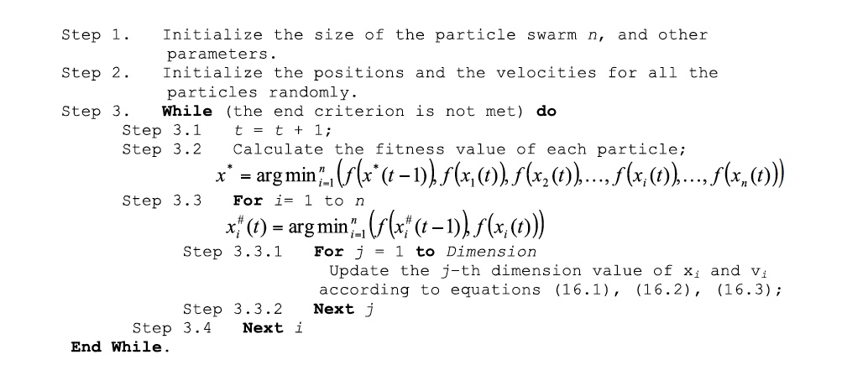
The Particle Swarm Optimization (PSO)
The value of v_{max} is p x s, with 0.1 ≤ p ≤ 1.0 and is usually chosen to be s, that is p = 1. The pseudo-code for particle swarm optimization algorithm is illustrated below:

Slide 10
The Particle Swarm Optimization (PSO)
The end criteria are usually one of the following:
maximum number of iterations: the optimization process is terminated after a fixed number of iterations, for example, 1000 iterations;
number of iterations without improvement: the optimization process is terminated after some fixed number of iterations without any improvement;
minimum objective function error: the error between the obtained objective function value and the best fitness value is less than a prefixed anticipated threshold.

Slide 11
The Particle Swarm Optimization (PSO)
There are 3 terms that contribute to creating the new velocity:
Inertia Term:
this term forces the particle to move in the same direction;
audacious tendency, following own way using old velocity.
2) Cognitive Term
this term forces the particle to go back to the previous best position;
conservative tendency.
3) Social Learning Term
this term forces the particle to move to the best previous position
of its neighbors;
sheep like tendency, be a follower.

Slide 12
Ant Colonies Optimization
Ants begin their search with equal (0.5 each) probability along each path. Clearly, the curved path is the longer and hence the time taken by ants to reach food source is greater than the others.
The ants through the shorter path reaches food source earlier. Now, evidently they face with a similar selection dilemma, but this time due to pheromone trail along the shorter path already available, probability of selection is higher.
More ants return via the shorter path and subsequently the pheromone concentrations also increase. Moreover, due to evaporation, the pheromone concentration in the longer path reduces, decreasing the probability of selection of this path in further stages. Therefore, the whole colony gradually uses the shorter path in higher probabilities. So, path optimization is attained.

Slide 13
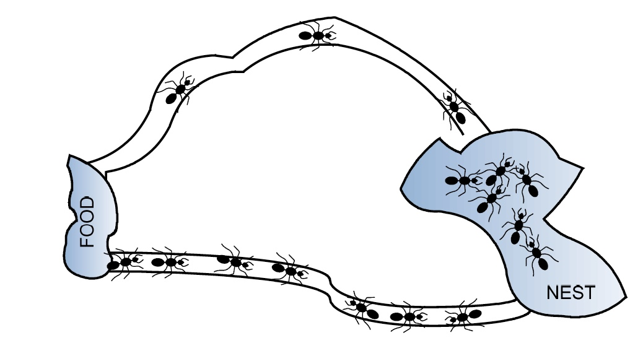
Ant Colonies Optimization
The ants taking the shortest path can perform a greater number of trips between nest and food; implicitly the pheromone trail will be more than the one released by the ants following the longest path.

Slide 14
Ant Colonies Optimization
Although an individual ant is quite small (measuring only 2.2 to 2.6 mm in length) and wanders quite aimlessly in isolation, a group of many ants exhibits extraordinarily intelligent behavior, recognizable to humans as meaningful pathways to food sources. This emergent intelligence can be summarized as:
At the outset of the foraging process, the ants move more or less randomly – this “random” movement is actually executed such that a considerable amount of surface area is covered, emanating outward from the nest.
If it is not carrying food, the ant “deposits” a nest pheromone and will prefer to walk in the direction of sensed food pheromone.
If it is carrying food, the ant deposits a food pheromone and will prefer to walk in the direction of sensed nest pheromone.
The ant will transport food from the source to the nest.

Slide 15
Ant Colonies Optimization Algorithm
pheromone trail initialization;
2) solution construction using pheromone trail;
Each ant constructs a complete solution to th m according to
a probabilistic rule;
3) state transition rule;
The state transition rule depends mainly on the state of the
pheromone;
4) pheromone trail update;
A global pheromone updating rule is applied in two phases. First, an evaporation phase where a fraction of the pheromone evaporates, and then a reinforcement phase where each ant deposits an amount of pheromone which is proportional to the fitness of its solution [21]. This process is iterated until a termination condition is reached.

Slide 16
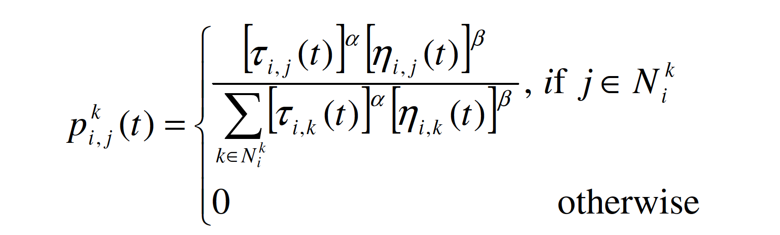
Ant Colonies Optimization Algorithm
Traveling Salesman Problem:
Starting from its start node, an ant iteratively moves from one node to another.
When being at a node, an ant chooses to go to an unvisited node at time t with a probability given by:
Where N_{i}^{k} -feasible neighborhood of the ant_{k} that is, the set of cities which
ant_{k} has not yet visited

Slide 17

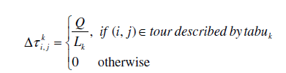
Ant Colonies Optimization Algorithm
τ_{i,j}(t) is the pheromone value on the edge (i, j) at the time t, is the weight of pheromone; ηi,j(t) is a priori available heuristic information on the edge (i, j) at the time t, β is the weight of heuristic information.
Two parameters α and β determine the relative influence of pheromone trail and heuristic information.
τi,j (t) is determined by:

Slide 18
Ant Colonies Optimization Algorithm
where ρ is the pheromone trail evaporation rate (0 < ρ < 1), n is the number of ants, Q is a constant for pheromone updating, L_{k} is the length of that path. A generalized version of the pseudocode for the ACO algorithm with reference to the

Slide 19
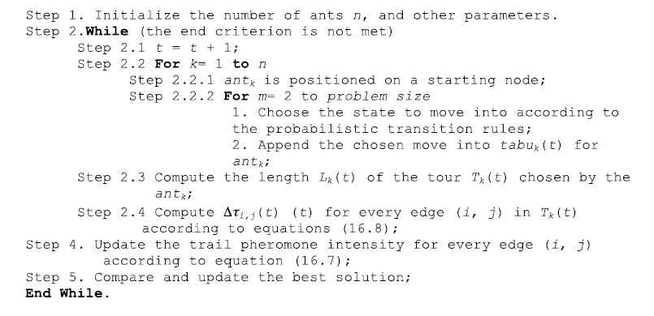
Ant Colonies Optimization Algorithm
TSP is illustrated below:

Slide 20
Summary
PSO is a population-based search algorithm and is initialized with a population of random solutions, called particles.
The PSO was first designed to simulate birds seeking food, which is defined as a ‘cornfield vector’.
In PSO, each single solution is like a ‘bird’ in the search space, which is called ‘particle’.
All particles have fitness values, which are evaluated by the fitness function to be optimized, and have velocities, which direct the flying of the particles.

Slide 21
Summary
There are some drawbacks, which the standard PSO algorithm encounters:
particles tend to cluster, i.e., converge too fast and get stuck at local optimum;
movement of particle carried it into infeasible region;
inappropriate mapping of particle space into solution space.

Slide 22
Summary
Newer version of the PSO have been developed with these features:
PSO with multiple social learning terms
Heterogeneous Particles;
Hierarchical PSO.
Measurement Indices for PSO: Two measurement indices which are Dispersion Index & Velocity Index

Slide 23
Dispersion Index
It measures how particles are spreading around the best particle in the swarm, and is defined as the average absolute distance of each dimension from the best particle.
It explains the coverage searching area of the swarm. A swarm with higher dispersion index has relatively wider coverage of searching area than the one with lower dispersion index.

Slide 24
Velocity Index
It measures how fast the swarm moves in certain iteration, and is defined as the average of absolute velocity.
It shows the moving behavior of the swarm: higher index means the swarm move more aggressively in moving through the problem space than the swarm with lower index.

Slide 25
Advantages & Disadvantages Of ACO
Advantages | Disadvantages
Positive feedback accounts for rapid discovery of good solutions; | It has a slower convergence than other heuristics;
Distributed computation avoids premature convergence; | It performed poorly for TSP problems larger than 75 cities;
The greedy heuristic helps find acceptable solution in the early solution in the early stages of the search process; | No centralized processor to guide the AS towards good solutions.
The collective interaction of a population of agents.

